Slide 1





4
2
1
5
3
Fluoropolymer Incineration:
Evidence for the Lack of PFAS Emissions
Philip H Taylor¹, Hans-Joachim Gehrmann², Krasmir Aleksandrov², Sven Herremans³, Meg Michell⁴, David Blye⁴, Deepak Kapoor⁵, Priyank Dalal⁵, Pyrianga Gunasekar⁵, Andrei Bologa², Philipp Bergdolt², Vanessa Nuredin², Dieter Stapf², M. Schlipf
H-J Gehrmann, et al., Mineralization of Fluoropolymers from Combustion in a Pilot Plant under Representative European Municipal and Hazardous Waste Combustor Conditions, Chemosphere, 365, 143403, 2024.https://doi.org/10.1016/j.chemosphere.2024.143403.

Slide 2
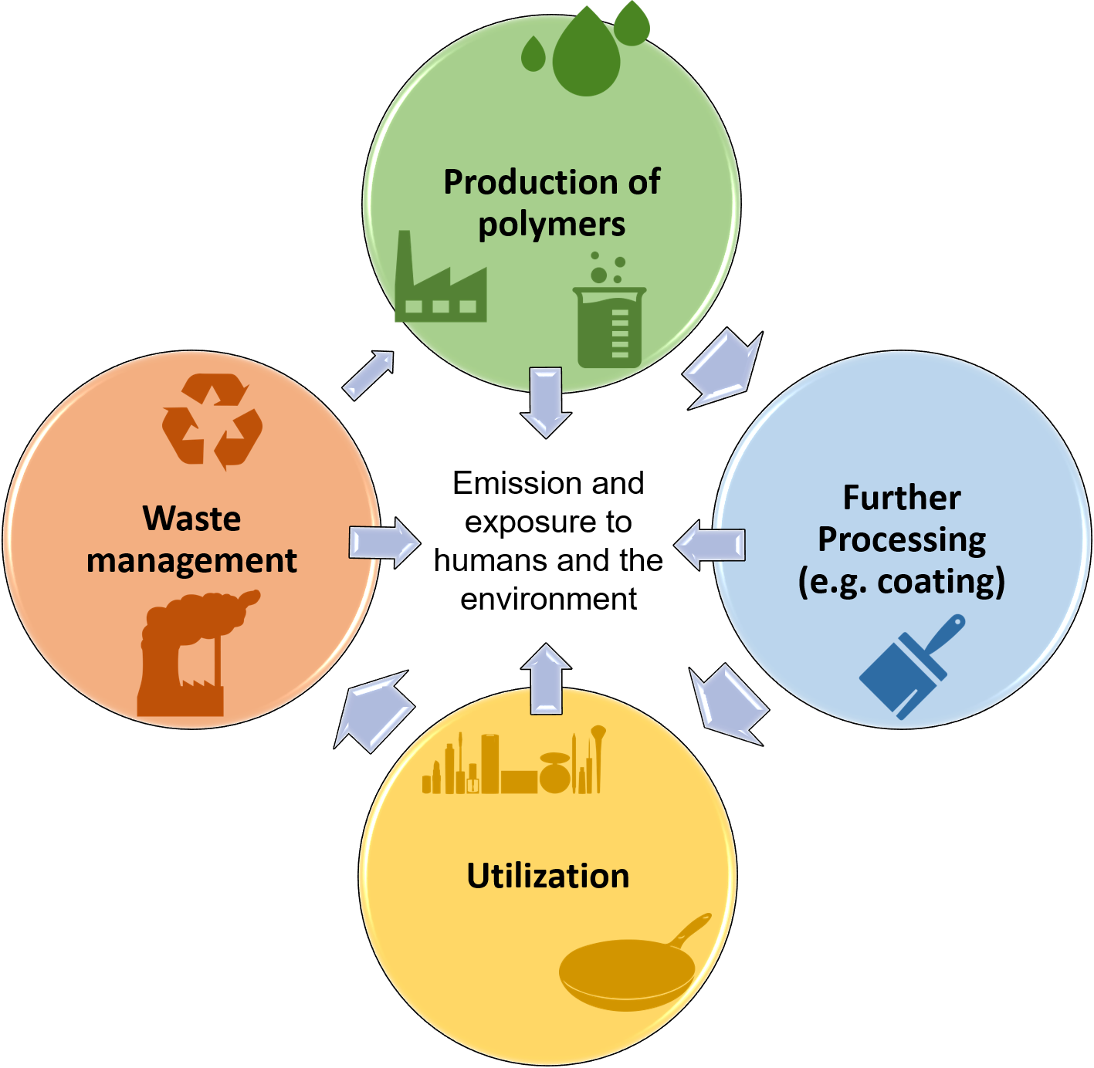
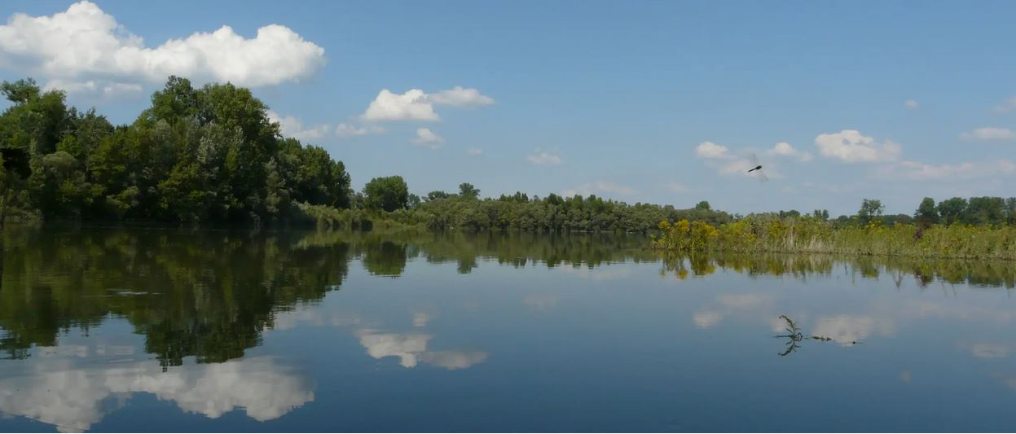
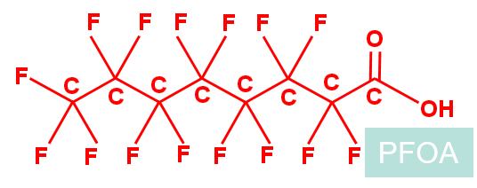
Introduction
Health effects
PFAS
Per- and polyFluoroAlkyl Substances
> 13000 human-made
chemicals
oil and water-resistant
high cholesterol
certain cancers
reduced vaccine response
pregnancy induced hypertension
https://www.spektrum.de/wissen/pfas-umweltgifte-fuer-die-ewigkeit/1724648, download 19.03.2024
ECHA
universal PFAS restriction proposal
ECHA receives more than 5600 comments
Source: https://echa.europa.eu/de/hot-topics/perfluoroalkyl-chemicals-pfas

Slide 3
Incineration of fluoropolymers:
PFAS analysis along the flue gas pathway
A pilot scale trial at operational conditions similar to municipal and industrial incineration plants that typically burn products containing fluoropolymers was conducted to assess the potential generation of any statistically significant uncontrolled emissions of Per- and Polyfluoroalkyl Substances at levels that might present a risk

Slide 4
Project partners
Research partner Institute for Technical Chemistry (ITC) at Karlsruhe Institute of Technology (KIT)
Sampling partner SGS Institut Fresenius GmbH, Industries & Environment
Laboratory partner SGS Belgium NV, Institute for Applied Chromatography
Feed sampling Pro-K, Fluoropolymer Processing and Downstream User Association, Germany
Incineration Advisor P Taylor & Associates, LLC, USA
Data quality review Environmental Standards Inc., USA
Observer UBA, Umweltbundesamt (German Federal Environment Agency)

Slide 5
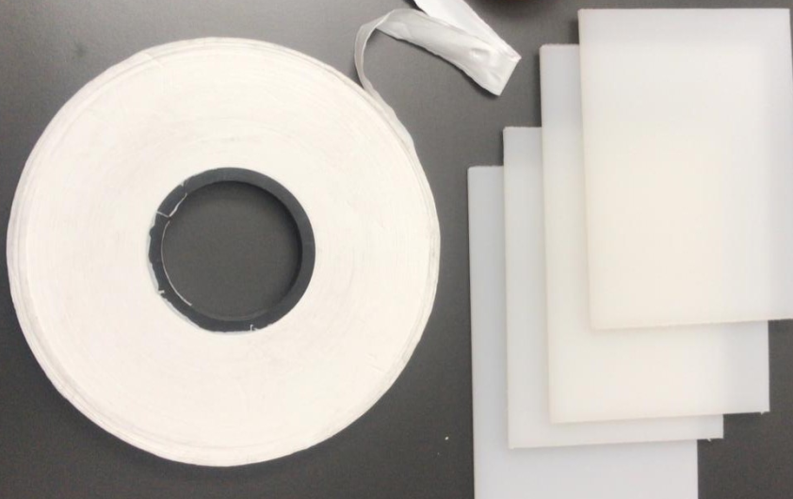
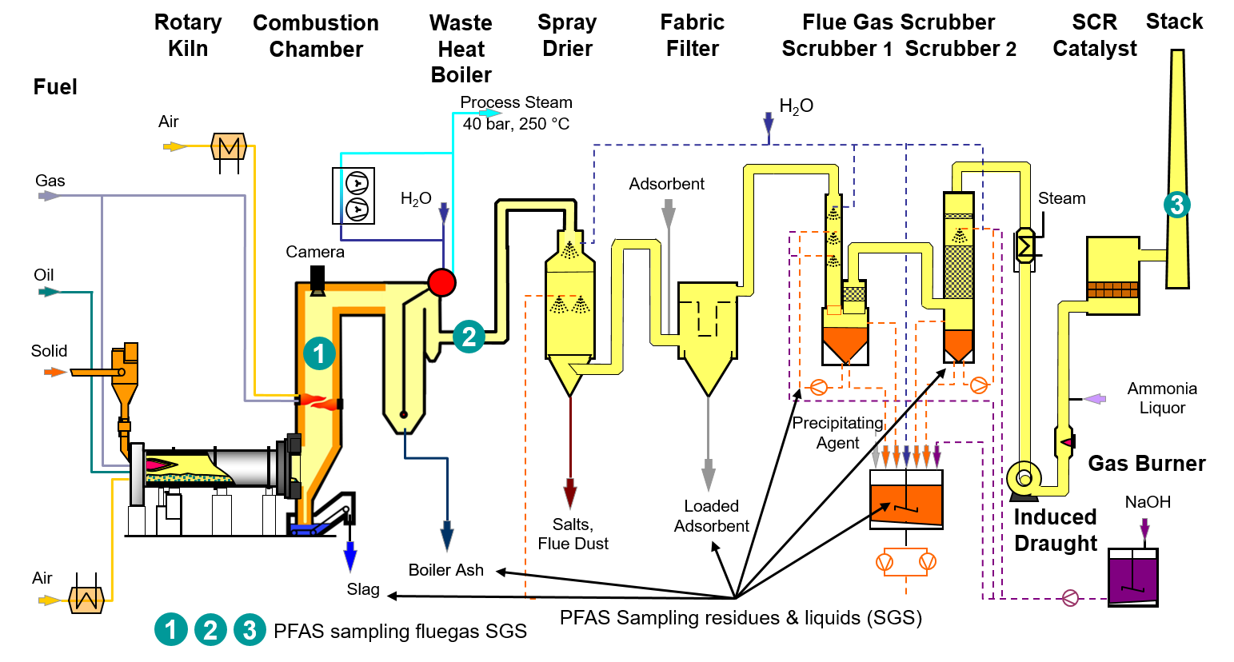
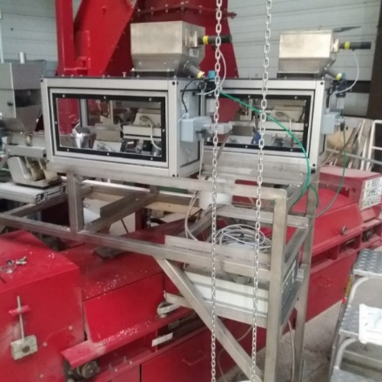
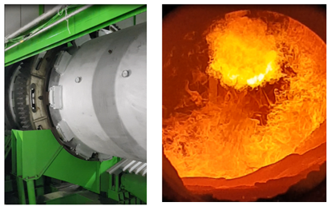
Test facility BRENDA / sampling locations
2.5 MW_{th}

Slide 6
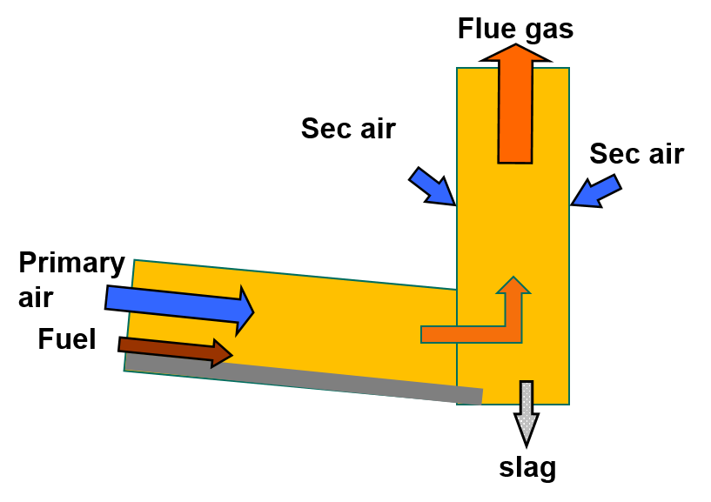
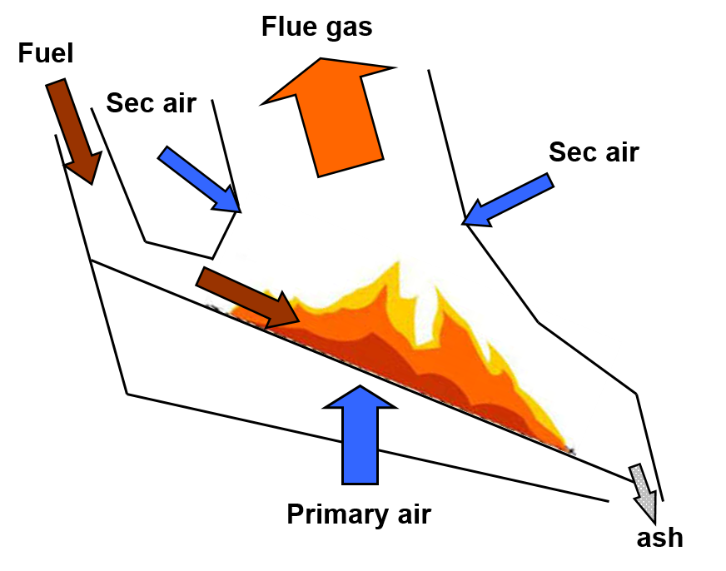
Flow regime in a kiln versus a grate
& fuel
& fuel
Co-current flow
Cross current flow
Source: Lecture „Thermal Waste Treatment“, IFK Stuttgart

Slide 7
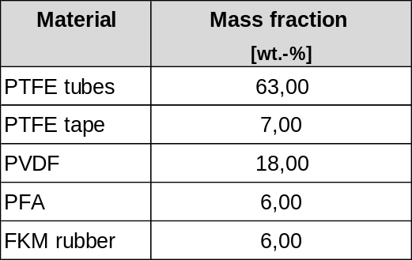
Experimental setup
Setting | Test Conditions
 | Background combustion with oil, natural gas and wood chips | Combustion with oil, natural gas, wood chips and FP | Background combustion with oil, natural gas and wood chips
 | Start-up of pilot plant
1 | RUN 1 | RUN 2 | RUN 3
 | Change of temperature in post-combustion chamber
2 | RUN 4 | RUN 5 | RUN 6
 | Shut down of pilot plant
Basis of fluoropolymer feed mixture:
Feed mixture comprises four largest volume fluoropolymers - PTFE, PVDF, PFA, FKM. Together these represent 80% of commercial fluoropolymer production
Pro-K supplied fluoropolymer samples of major applications that were grinded and mixed
mass flow = 320 g/h

Slide 8
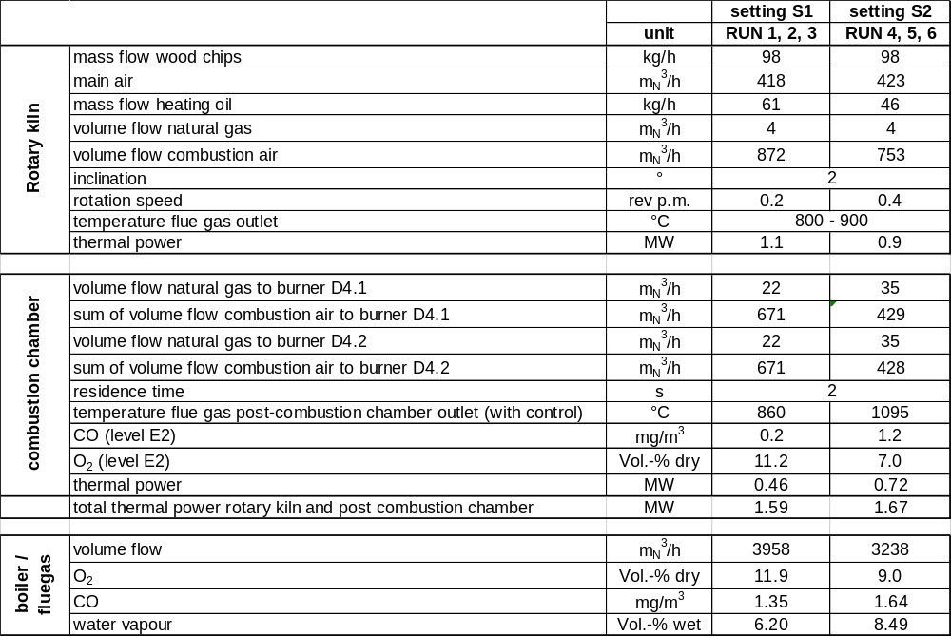
Main operational parameters, setting 1 and 2
Increase of rotation speed to avoid slagging
- 200 kW, shift thermal power to the PCC
Increase of temperature by reduction of
stoichiometric air/fuel ratio
+ 260 kW, total power ≈ constant
Setting S1:
conc. CO = 1,35 [mg/m³] = 4.5 ppm
Setting S2:
conc. CO = 1,64 [mg/m³] = 6.58 ppm

Slide 9
Sampling and Analysis
SGS sampling train
Ultrahigh-Performance Liquid Chromatography coupled to tandem Mass Spectrometer (UPLC-MS/MS) for targeted long-chain PFAS and Trifluoroacetic Acid (TFA)
Gas Chromatography coupled to Mass Spectrometry (GC-MS) for volatile fluorocarbons
Tunable diode laser (TDL) for Hydrogen Fluoride at boiler exit
Ion Chromatography for fluoride ion at the stack

Slide 10
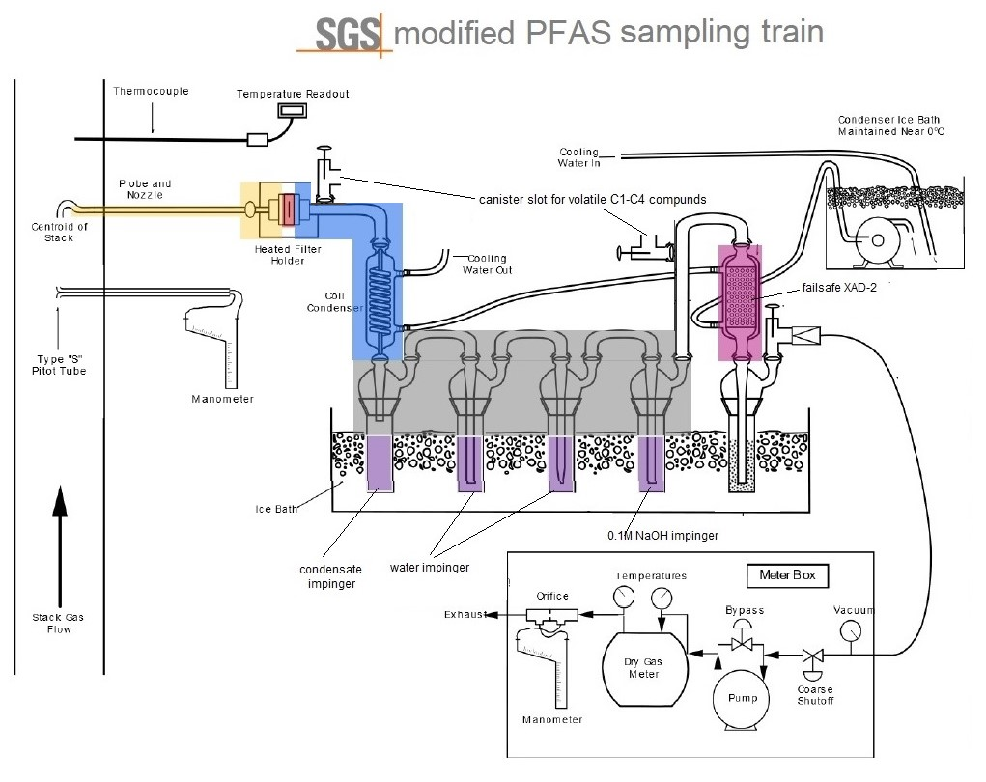

Slide 11
Testing methodology
27 samples analyzed per setting
3 samples were collected and analyzed at each sampling point per setting (triplicate sampling)
PFAS analyzed at Pre-run, Run and Post-run conditions
Scrubber water and ash samples analyzed for target PFAS content
Blank media and solutions were analyzed for their respective parameters
Blanks from sample train were analyzed at relevant sample locations

Slide 12


Statistical evaluation, example for PFBA
Measured value PFBA < LOQ
→ c = 0
Measured value PFBA < LOQ
→ c = ½ LOQ
Value
RUN 1*
Value RUN 1 + ½ LOQ
Median (50. Percentile)
Median (50. Percentile)
[ng/m_{N}³ dry]
[ng/m_{N}³ dry]
* from quartz filter, in the condensate and in the three impingers all values are < LOQ
Source: Compendium of water sampling, measurement and analysis 2024, https://reflabos.vito.be/2024/WAC_IV_A_025.pdf, only in Dutch available, on page 14, first line: If a sum of PFAS needs to be made, the "lower bound principle" needs to be applied.

Slide 13
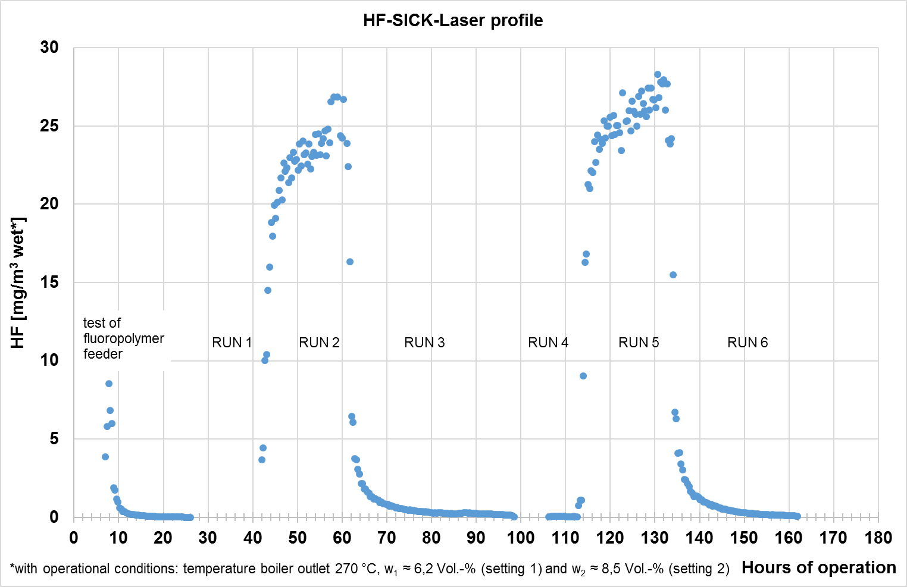
HF measurement at boiler exit (Tunable Diode Laser)

Slide 14
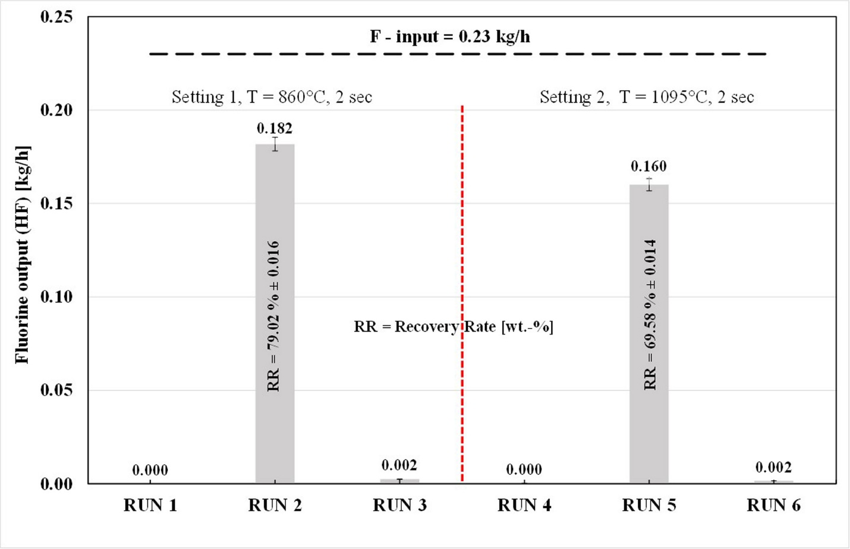
Fluorine mass balance

Slide 15
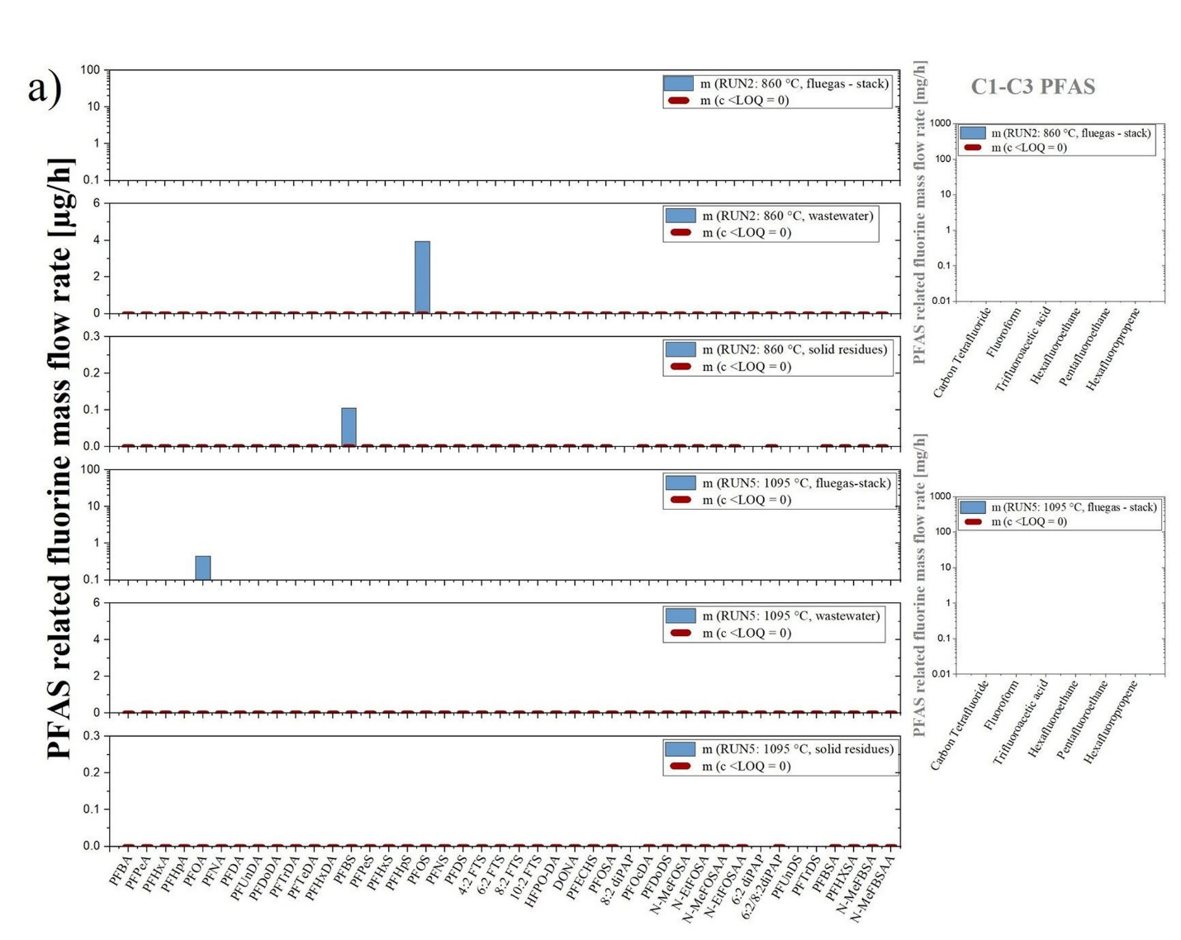
Fluorine mass emission rates from PFAS

Slide 16
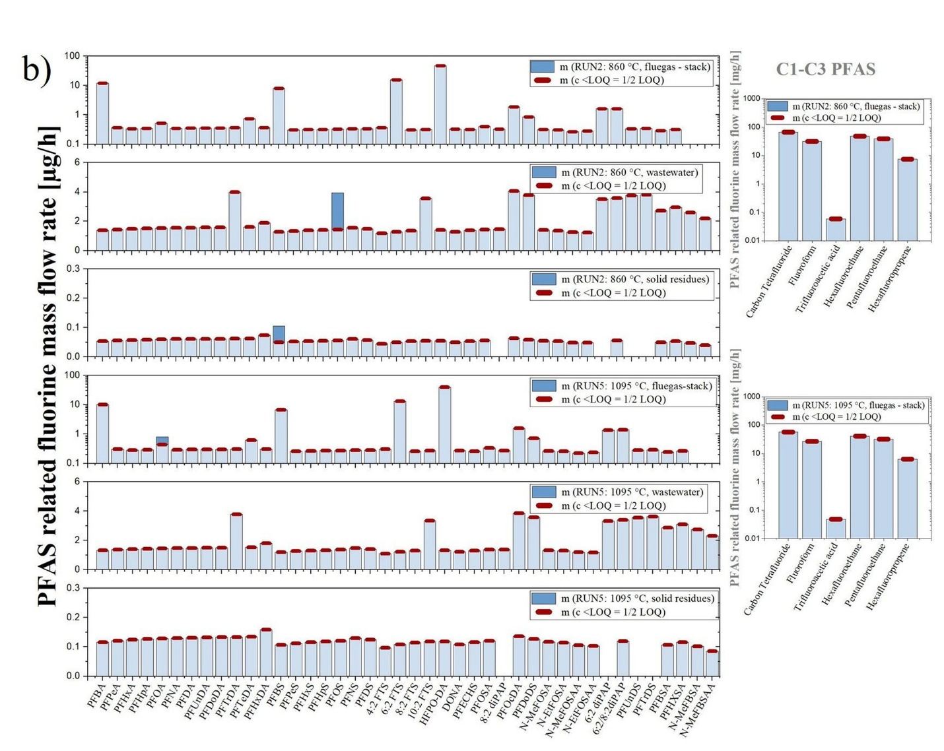
Fluorine mass emission rates from PFAS

Slide 17
Results
Targeted PFAS analysis: Statistical analysis of the PFAS emissions measurements indicated that PFOA was the only PFAS that was detected above the LOQ (0.20 ng/m³) in the stack gas sample in the 1095°C FP combustion test. This result is not considered definitive, however, as PFOA was also detected in 8 other combustion test samples where the FP was not fed (at levels ranging from 0.04 -1.19 ng/m³).
PFAS analysis of wastewater and ash residue: Statistical analysis of the wastewater and ash residue samples indicated that PFBS and PFOS were detected above the LOQ. These results are questionable given that the FP fed did not contain measurable amounts of sulfur. The source of the PFBS and PFOS may be memory effects or the presence of traces of sulfur in the wood chips fed to support the combustion process.
Trifluoroacetic acid: TFA was not detected at a reporting limit of 50 ng/m³.
GC-MS analysis for short chain fluorocarbons: C₁-C₃ fluorocarbons were non detected in the flue gases at LOQs ranging from 5 - 40 μg/m³.
Fluorine Recovery: Fluorine recoveries ranged from 70 to 80% using Tunable Diode Laser detection of HF - provides strong evidence for mineralization of the fluoropolymer feed mixture.

Slide 18
Conclusions
Fluoropolymers in incinerators operated according to the EU Directive regulations are converted to inorganic fluorides and carbon dioxide.
Statistical analysis of the combustion runs demonstrated that PFOA was the only detectable PFAS in the gas stream. Seven other PFAS were detected in the FP combustion runs but were considered outliers in the statistical analysis.
Inorganic fluorides were detected as hydrogen fluoride (between 70 to 80 wt. % F recovery). Lower F recoveries at 1095°C suggest that F feed rate may not have been well controlled.
The decrease in PCC temperature from 1095°C to 860°C did not show an increase in PFAS, TFA, or C₁-C₃ emissions.
Fluoropolymers pose low risk to human health and the environment at their end of life when incinerated.

Slide 19
Acknowledgements
This study was funded by Gujarat Fluorochemicals GmbH
For further information, contact:
Deepak Kapoor: dkapoor@gfl.co.in
Phil Taylor: Taylorphd6397@gmail.com
Hans-Joachim Gehrmann: Hans-Joachim.Gehrmann@kit.edu

Slide 20

Questions?
for your attention!

Slide 21
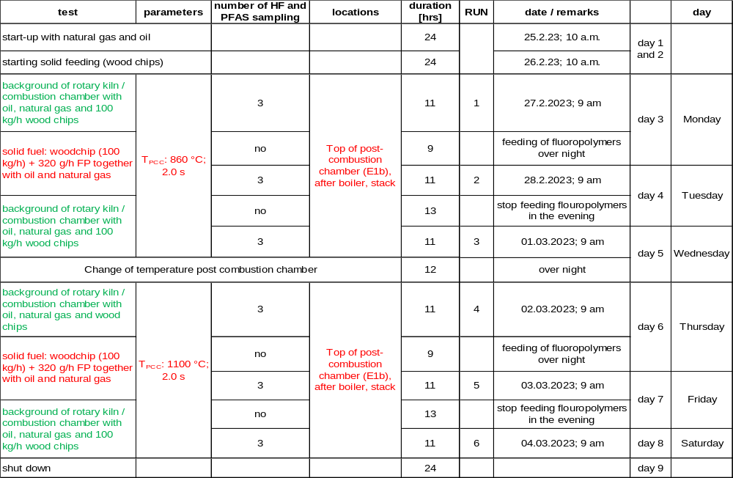
Experimental setup
mass flow = 320 g/h
Basis of fluoropolymer feed mixture:
Feed mixture comprises of four largest volume fluoropolymers - PTFE, PVDF, PFA, FKM. Together these represent 80% of commercial fluoropolymer production
Pro-K supplied fluoropolymer samples of major applications that were grinded and mixed

Slide 22
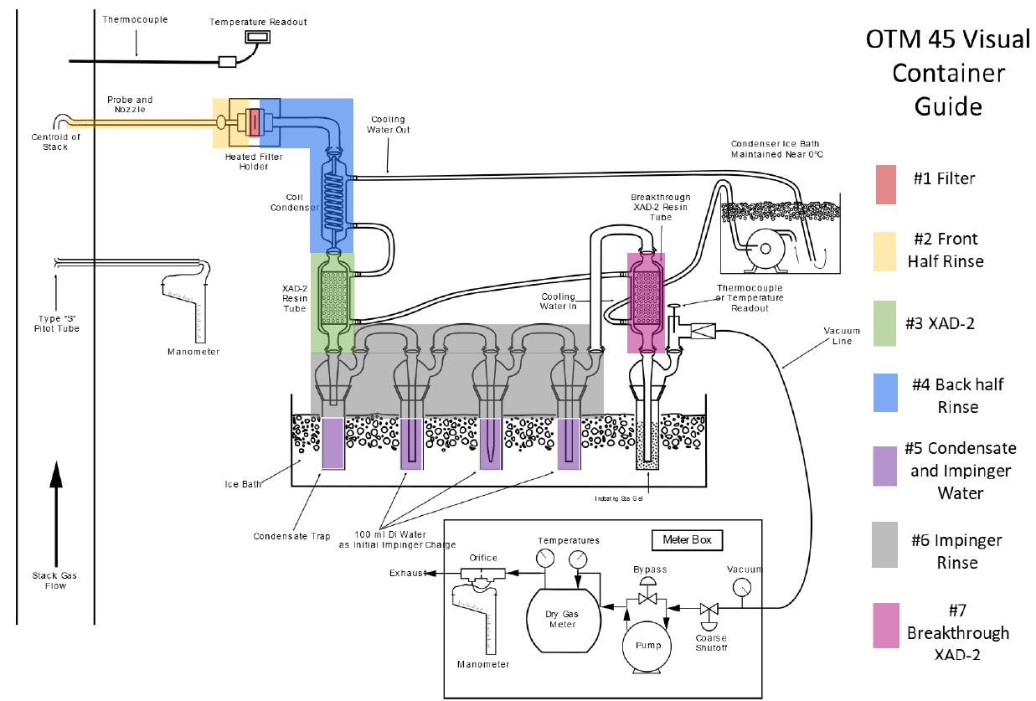

Measurement and Analytics OTM 45
Rinsing solution: 5% ammonium hydroxide in methanol
Impinger bottles are analyzed individually
Blank values are measured
Setup and methodology are modified according to the experience of the sampler
X
modification by SGS
03.03.2025

